Slide 1

Recommender Systems
تحت إشراف الدكتورة :
د. ميساء أبوقاسم

Slide 2
Introduction to rss
What are Recommender Systems?
Why do we need Recommender Systems?
How do Recommender Systems work?

Slide 3
What are recommender systems?
People you may know
YouTube recommended videos
Google ads or recommended products

Slide 4
Why do we need rss?
Very large Data problem
Faster search time
Excellent user experience

Slide 5
How do rss Work?
Two types of data :
User ( profile, likes, ...)
Item ( type, price, ......)
Three Algorithms :
Content-based systems
Collaborative filtering
Hybrid system

Slide 6
Collaborative filtering
CF
What are the types of CF?
Which type is better and why?
What is CF?

Slide 7
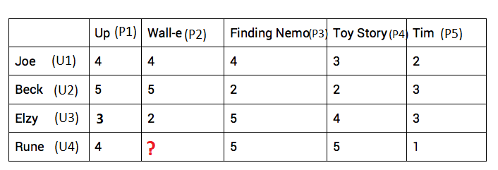
Types of cf
User-to-user: find similar users and recommend items that they like.
Item-to-item: find similar items based on ratings given by other users.

Slide 8
Which one is better?
Item-Based Collaborative filtering are better because it solves the sparsity and scalability challenges that User-Based CF have.

Slide 9
What is cf?
Problem formulation:
Y(i,j) = rating of user i on item j
R(i,j) = 1 if user has rated item j (0 otherwise)
 | U1 | U2 | U3 | U4
P1 | 5 | 5 | 0 | 0
P2 | 5 | ? | ? | 0
P3 | ? | 4 | 0 | ?
P4 | 0 | 0 | 5 | 4
P5 | 0 | 0 | 5 | ?

Slide 10

θ(j) = Parameter vector for user j.
x(i) = Futures vector for item i.
 | U1 | U2 | U3 | U4 | X1(Drama) | X2(Action)
P1 | ? | 5 | 0 | 0 | 1 | 0
P2 | 5 | ? | ? | 0 | ? | ?
P3 | ? | 4 | 0 | ? | ? | ?
P4 | 0 | 0 | 5 | 4 | ? | ?
P5 | 0 | 0 | 5 | ? | ? | ?
θ | [5,0] | ? | ? | ? | ? | ?
Predict the rating for user U1 on item P1:
$\hat{y}= θ^{T}. x$ = 5x1 + 0x0 = 5

Slide 11

How to get the values $θ$ and $x$ ?!

Slide 12
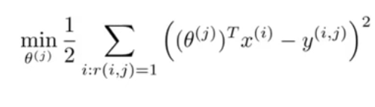

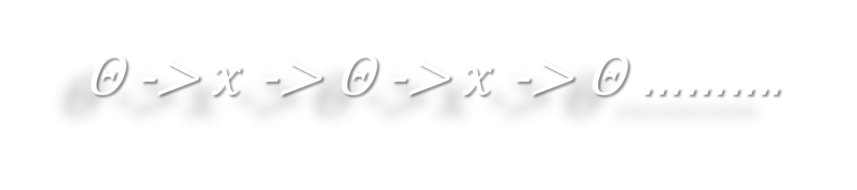

θ and $x$ vectors are initialized with small random numbers.
Loss function:
We can use gradient descent algorithm to update $x$ and θ vectors and minimize the loss.
For given $x$ we can estimate θ and for given θ we can estimate $x$ and so on until we minimize the loss.
θ -> $x$ -> θ -> $x$ -> θ ……….

Slide 13

Collaborative filtering algorithm
Initialize θ and $x$ vectors with small random numbers.
Define a loss function.
Minimize loss using gradient descent.
For user with parameters θ and item with futures $x$ the rating prediction is: $θ^{T}. x$

Slide 14
Deep learning
Is deep learning used in RSs?
Why deep learning?

Slide 15
Application of deep learning in rss
Learning item embedding
Deep CF
Conversational Search
Feature extraction from content

Slide 16
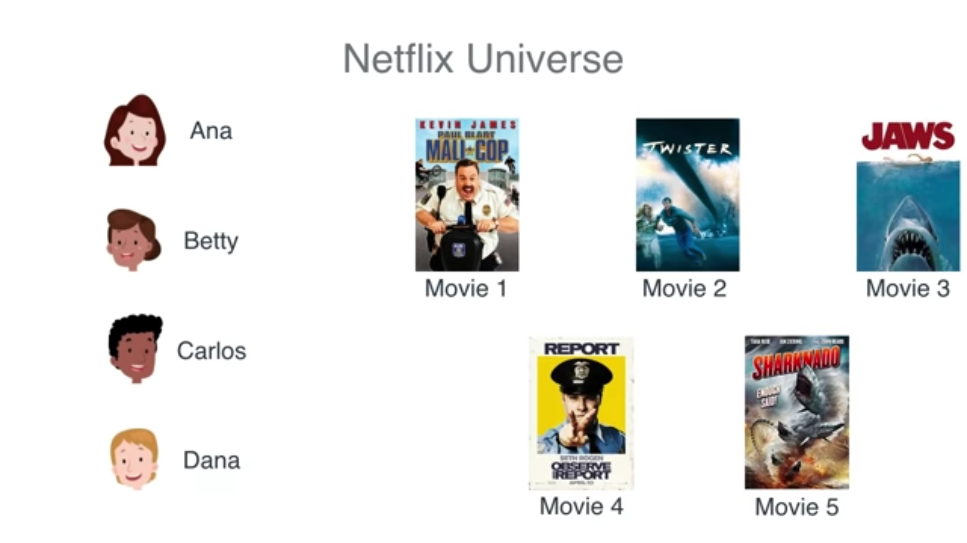

Slide 17
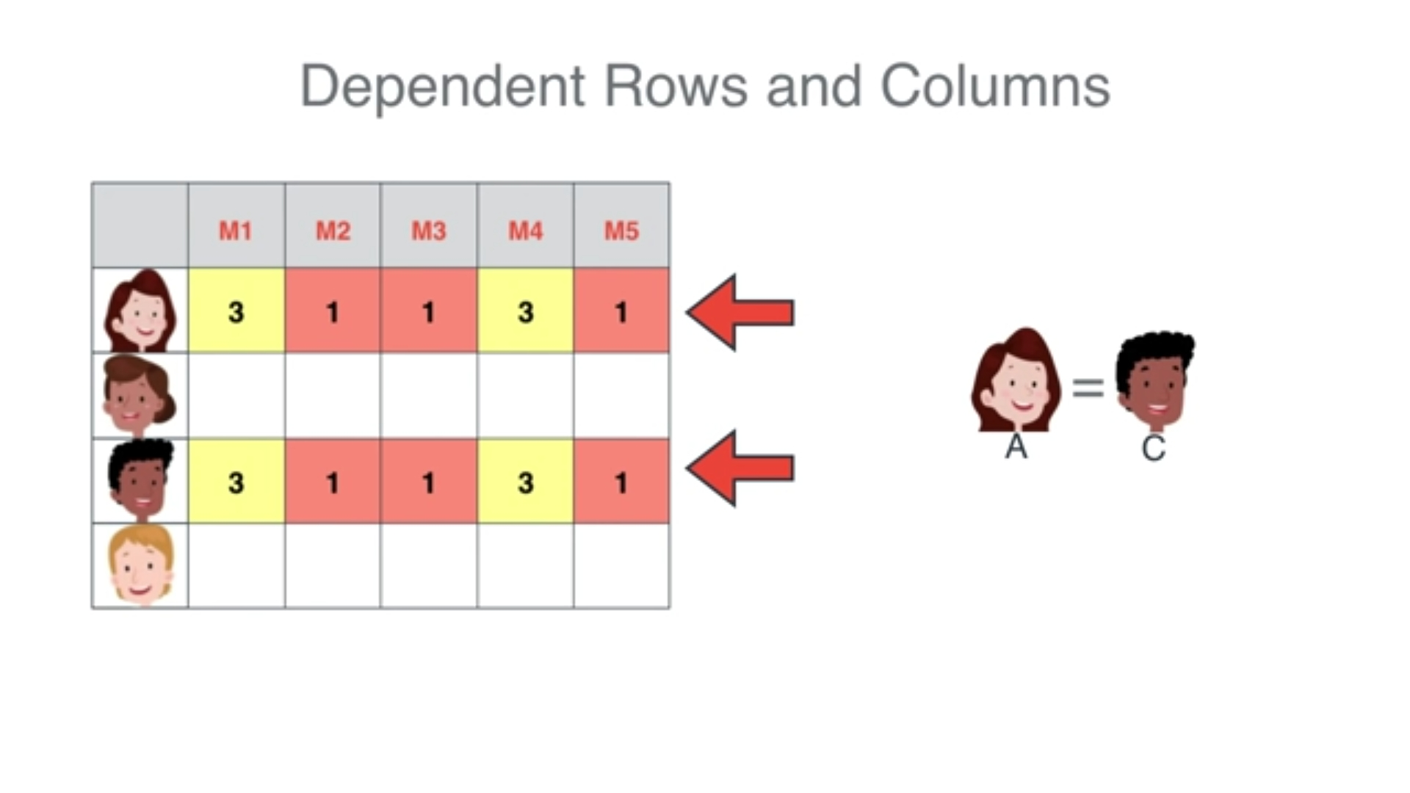
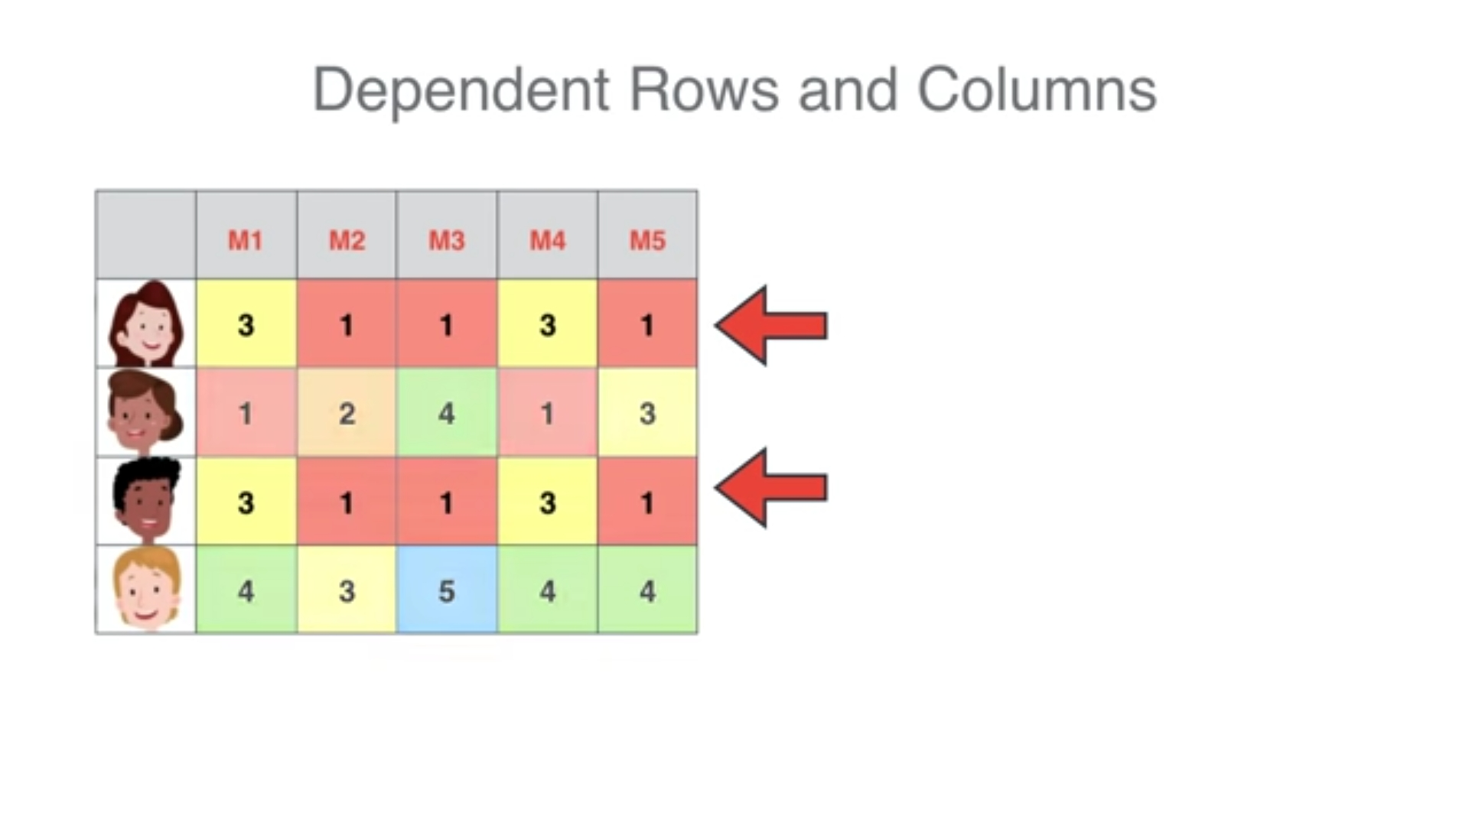
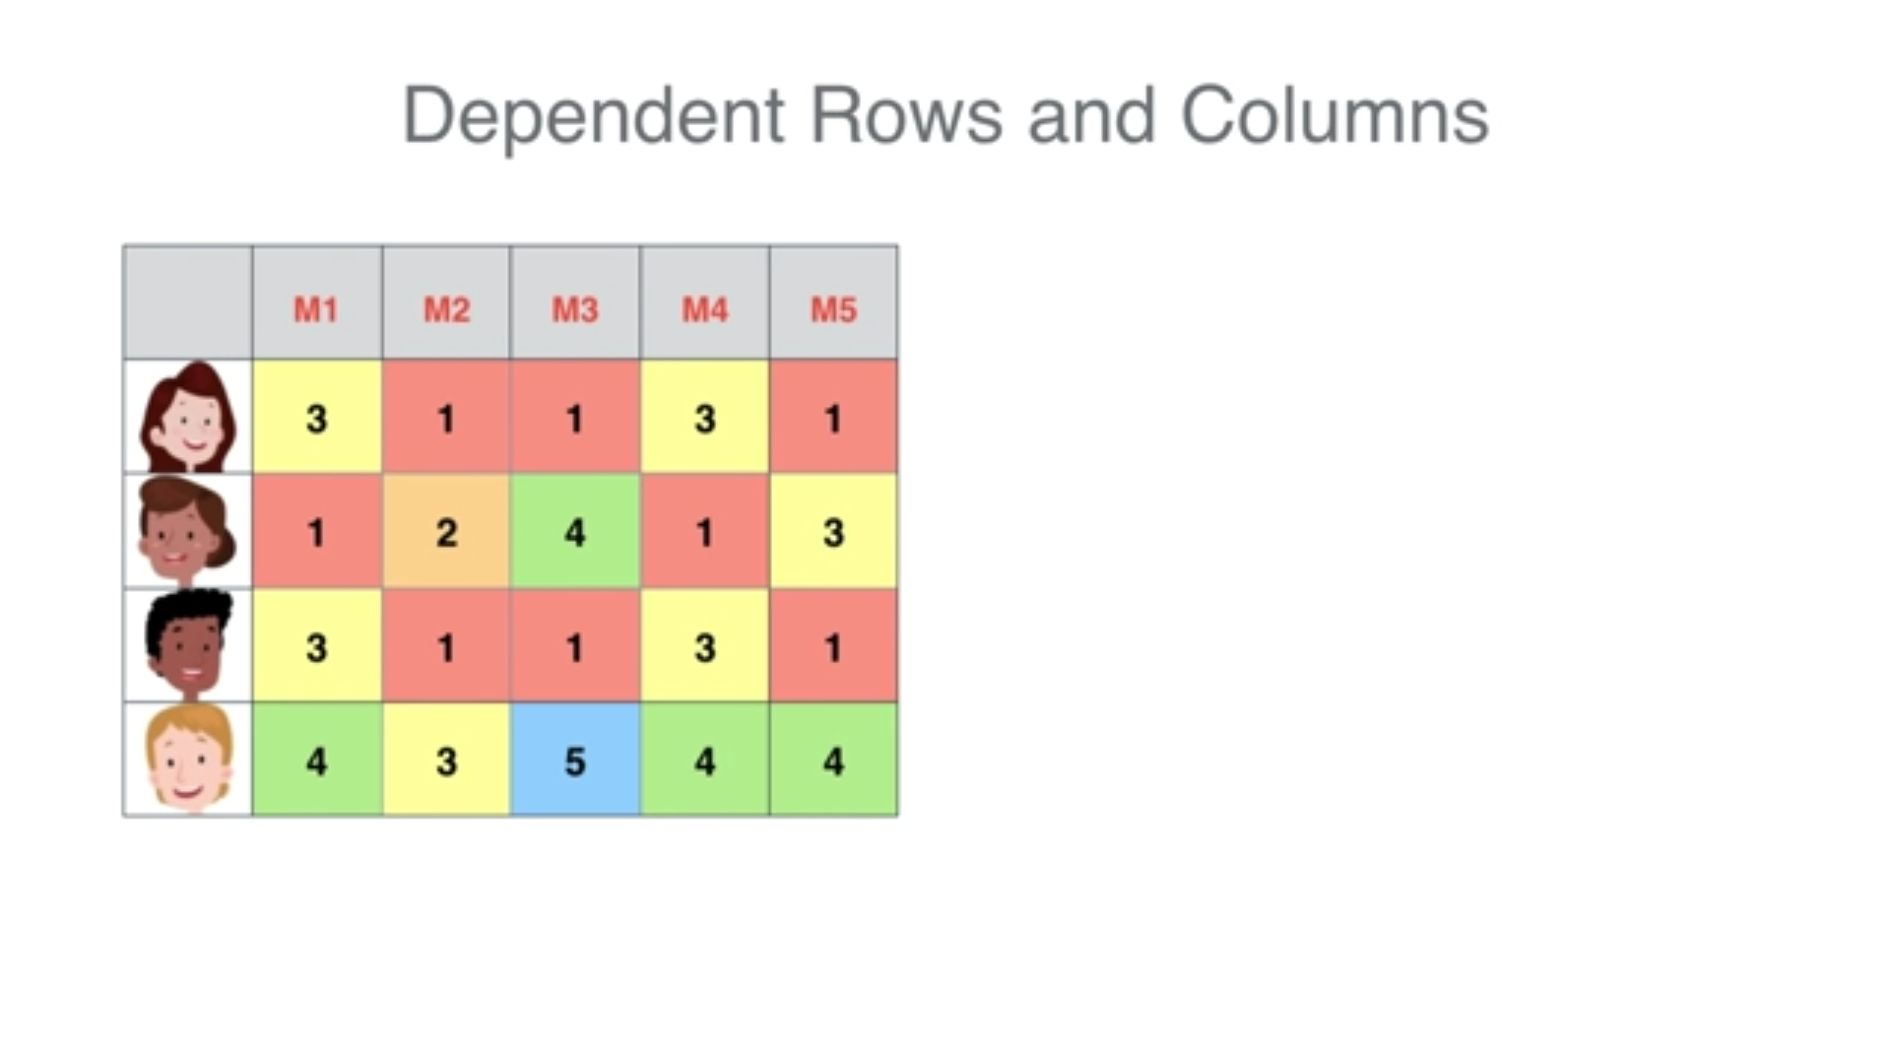

Slide 18
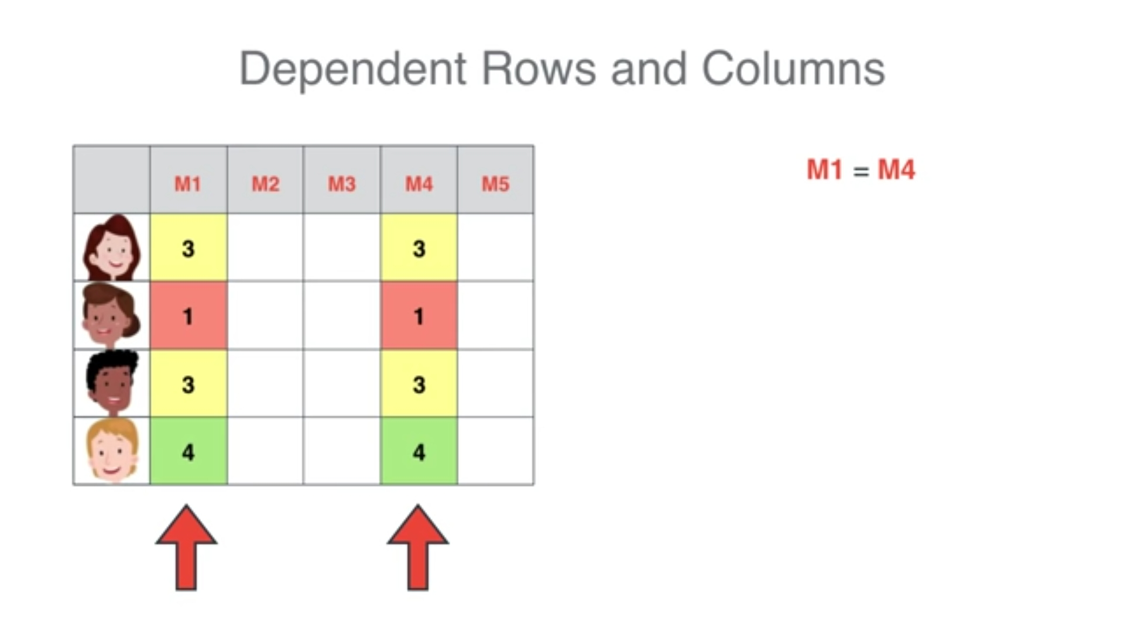
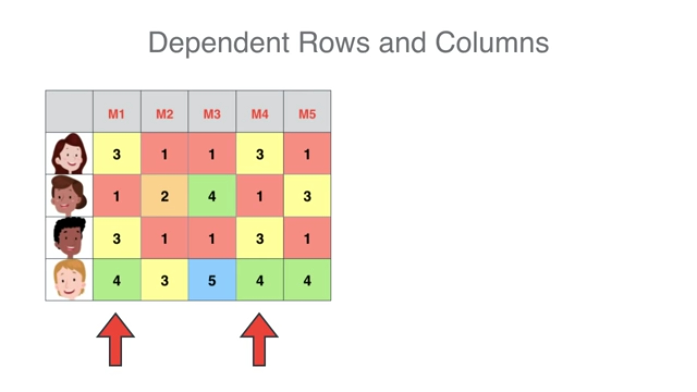

Slide 19
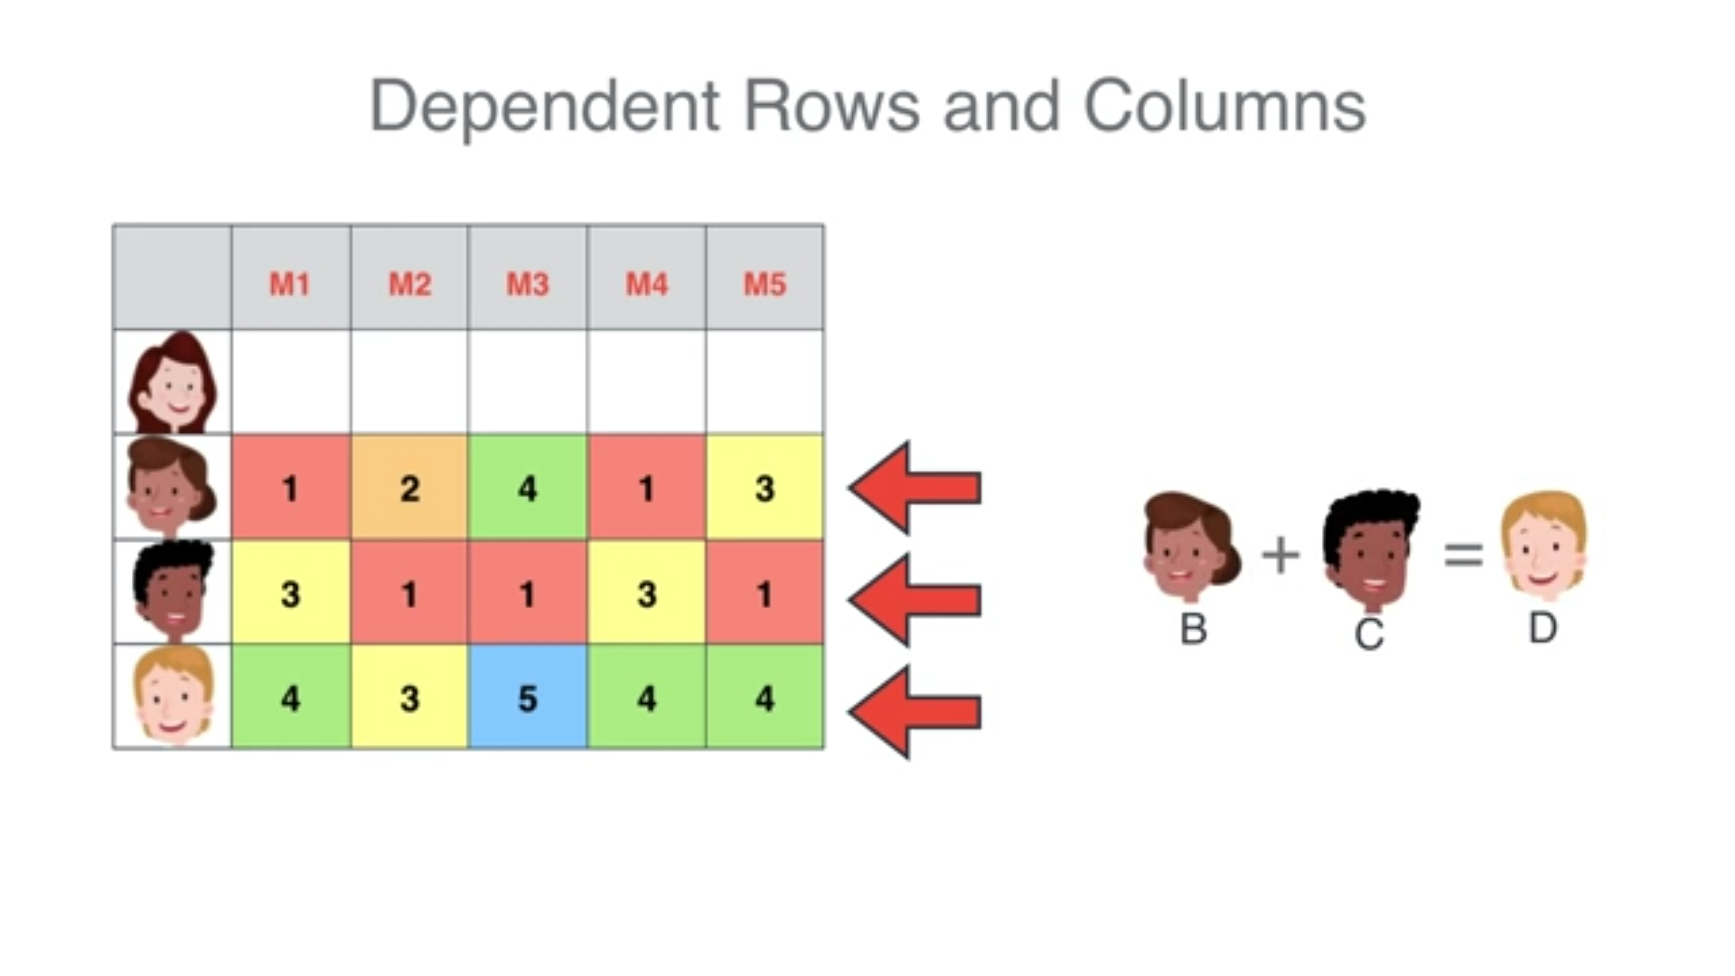
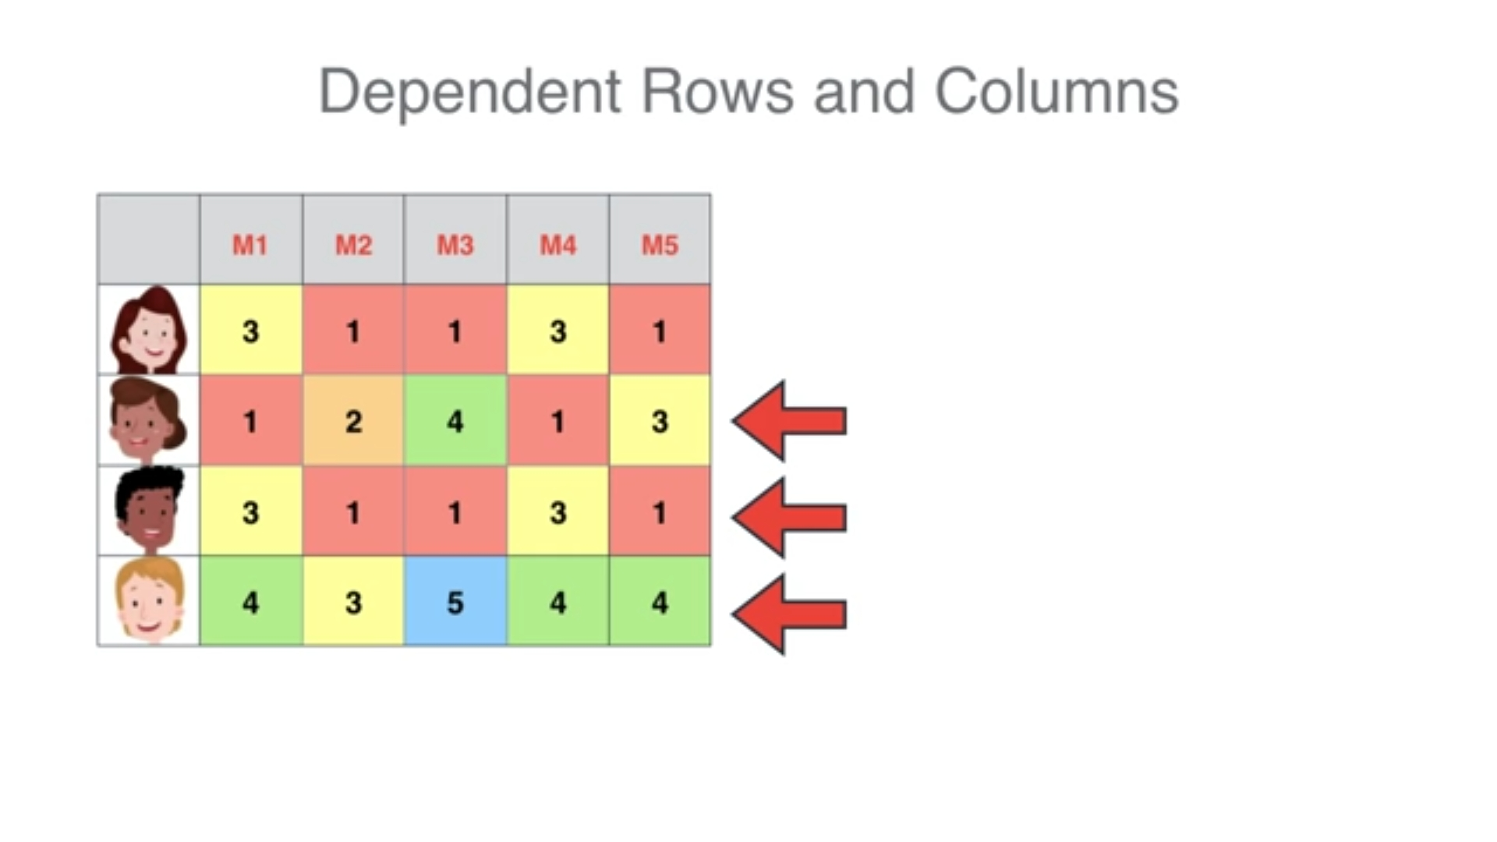

Slide 20
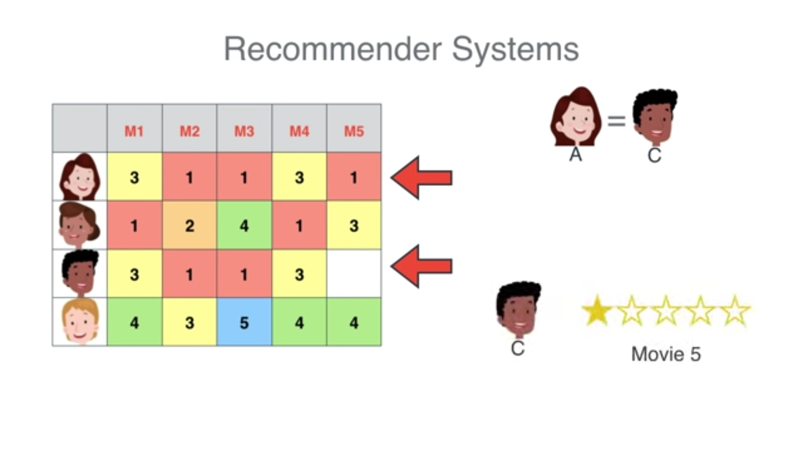
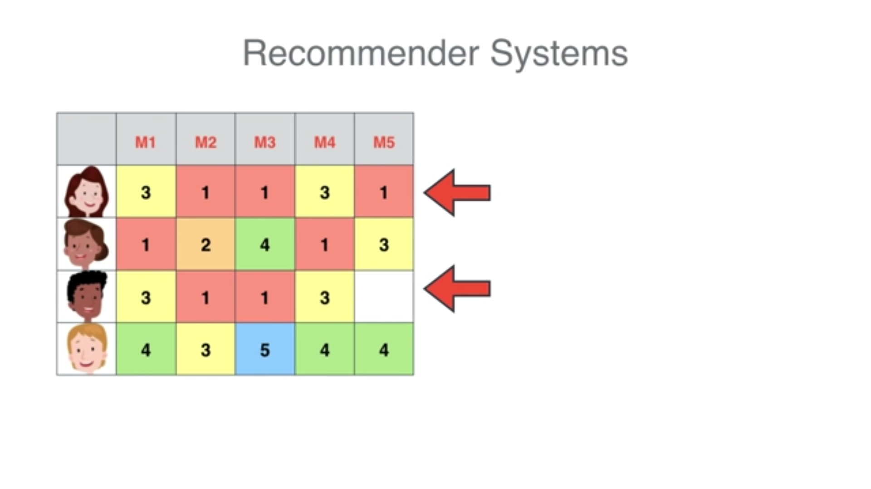
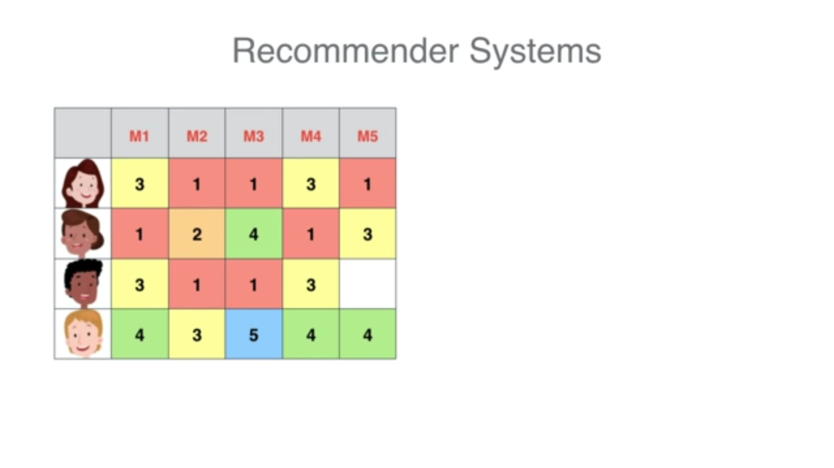

Slide 21
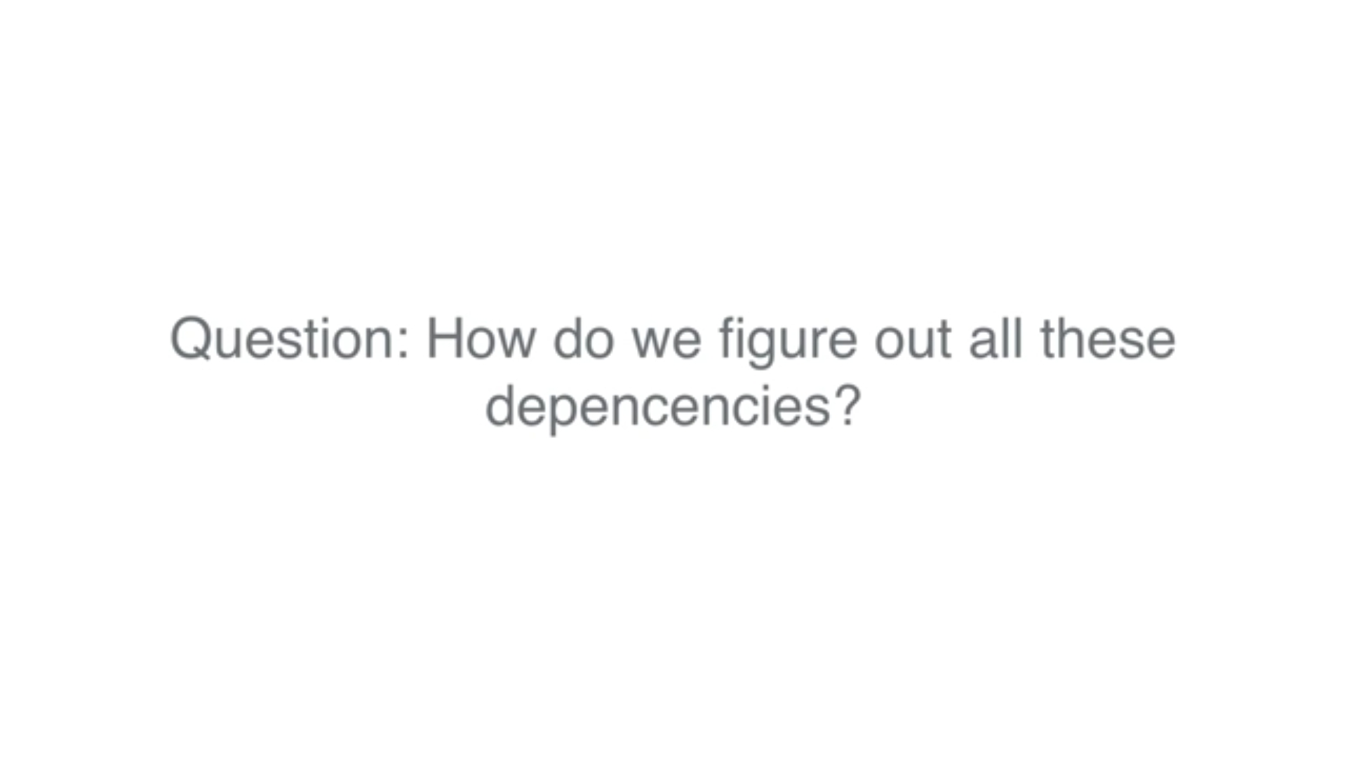

Slide 22
Matrix factorization

Slide 23
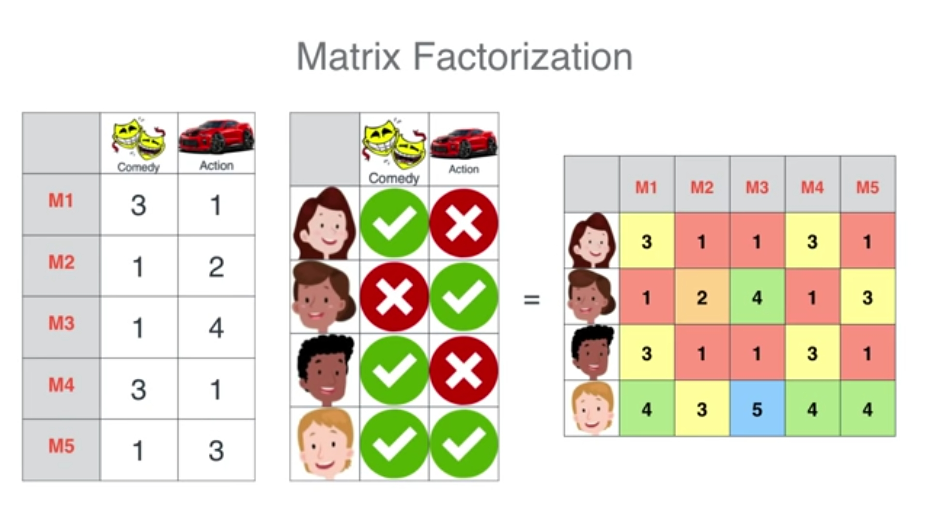
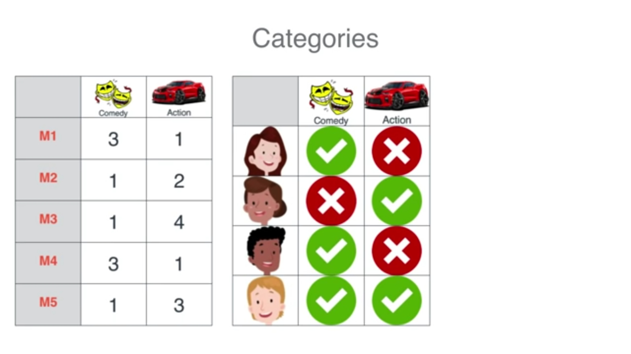
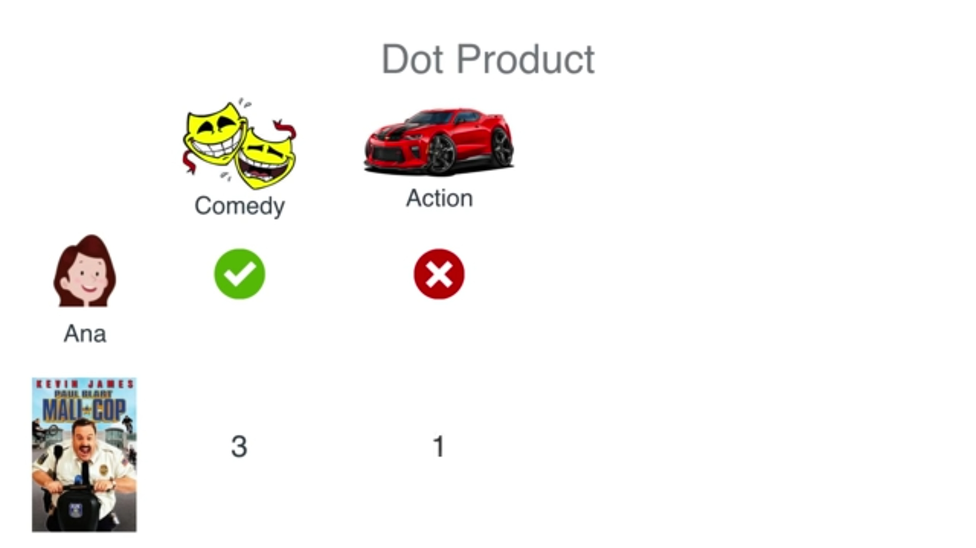
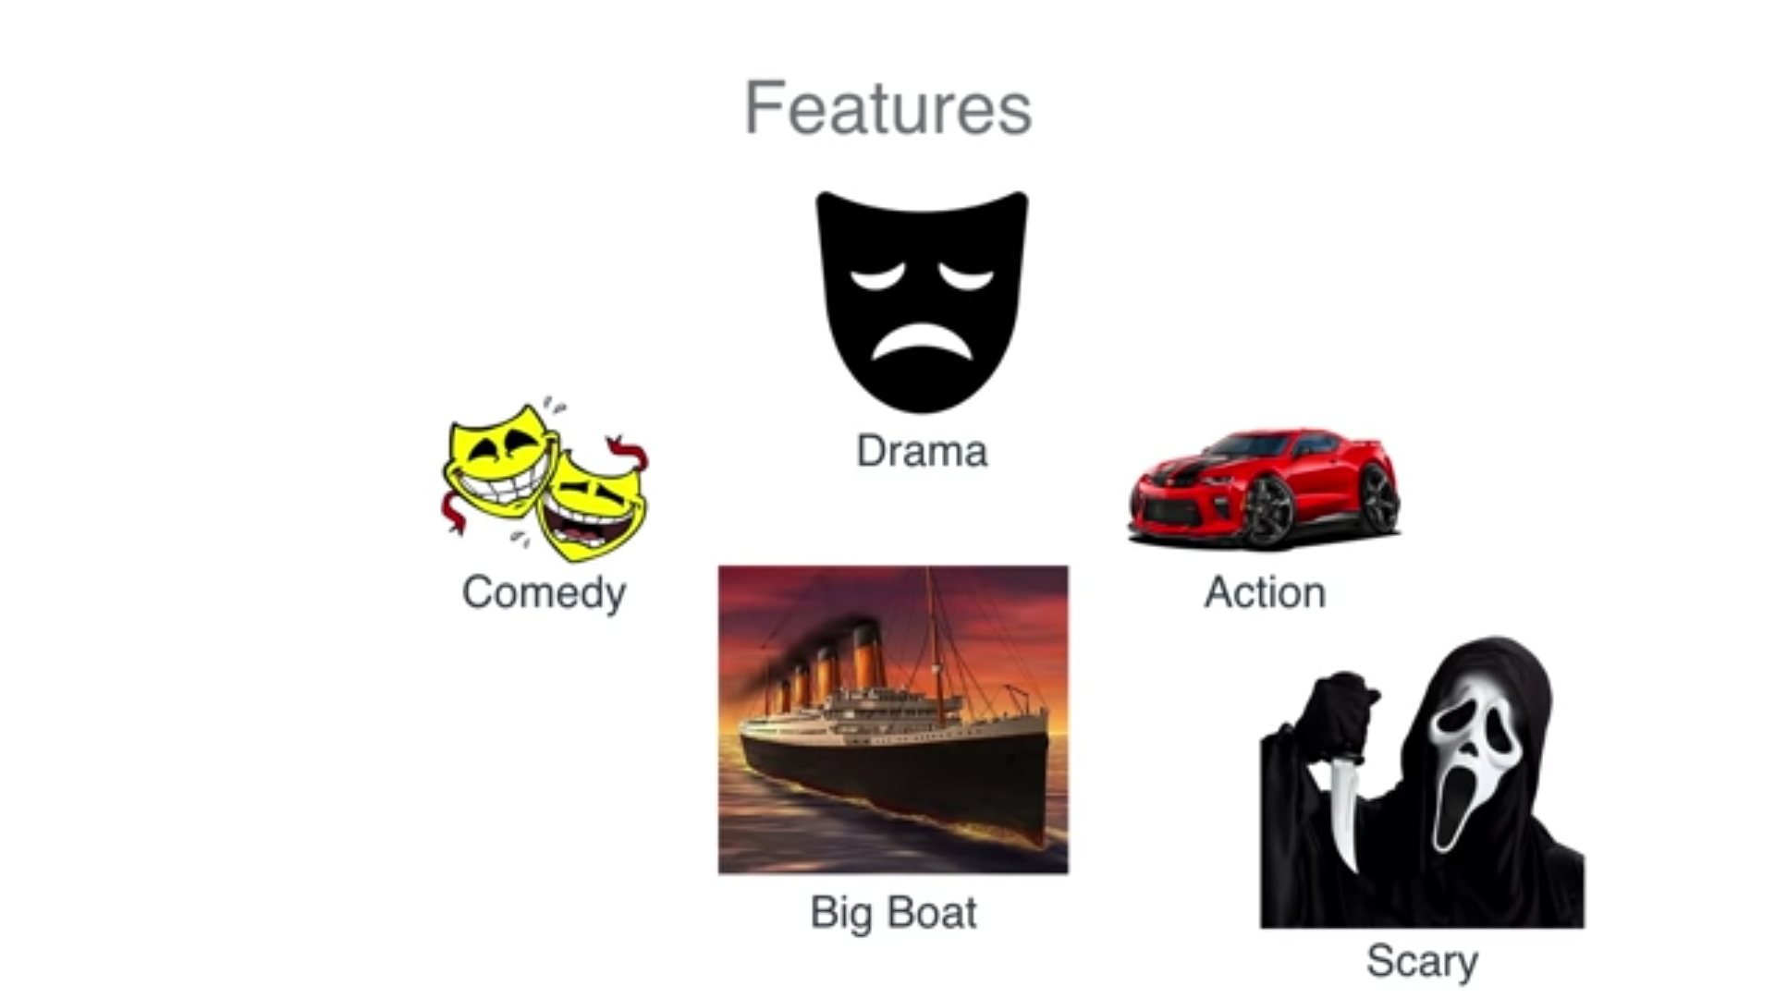

Slide 24
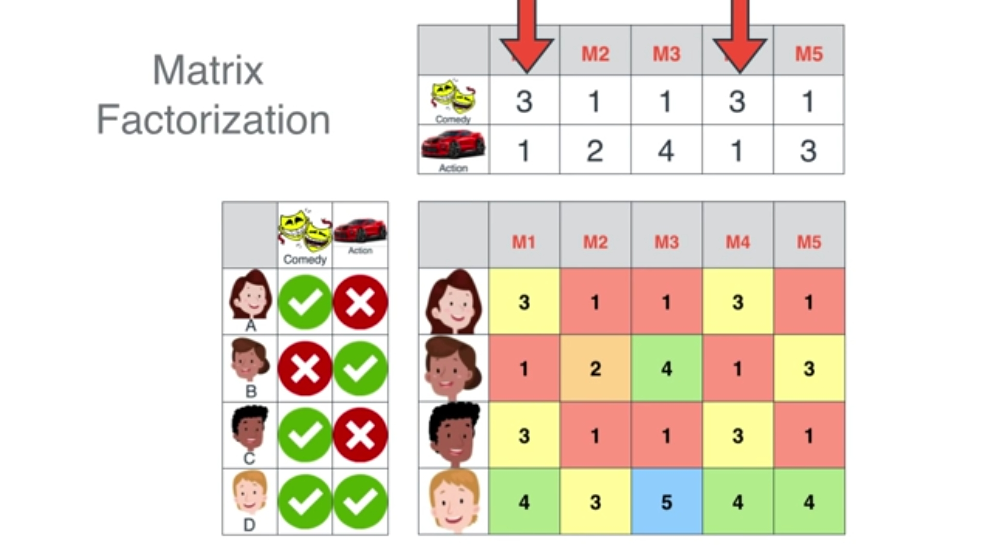
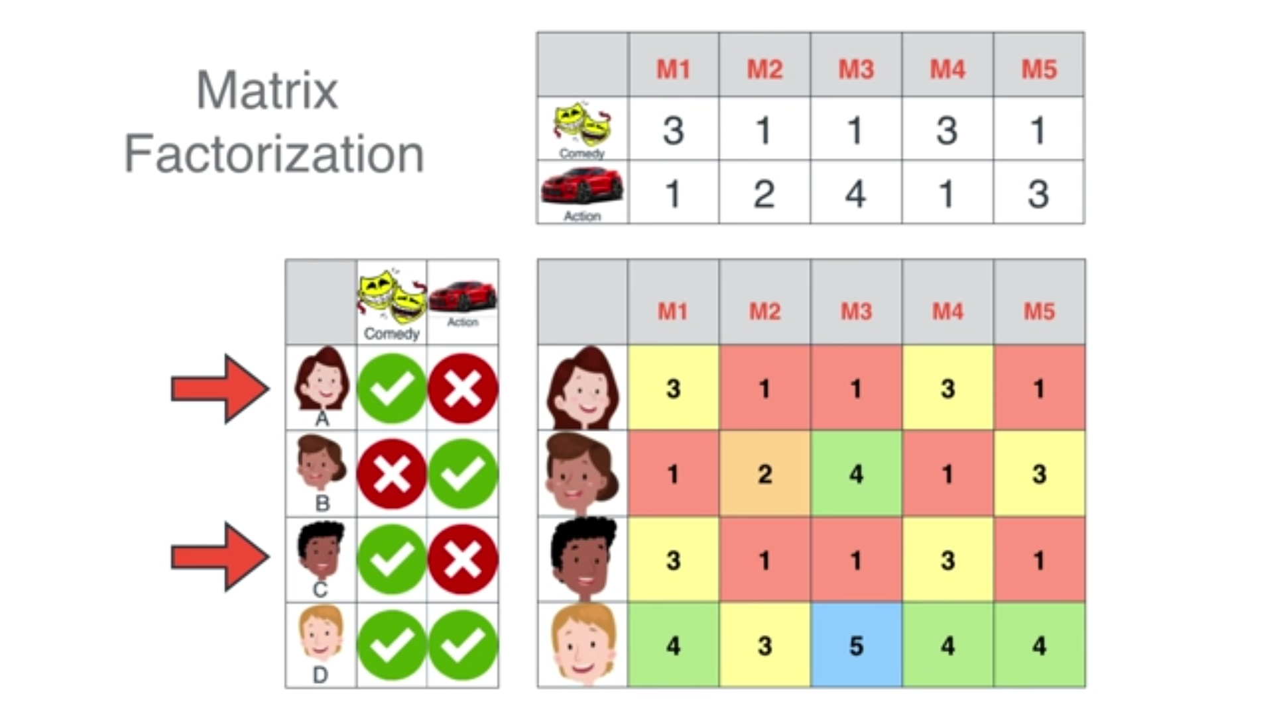
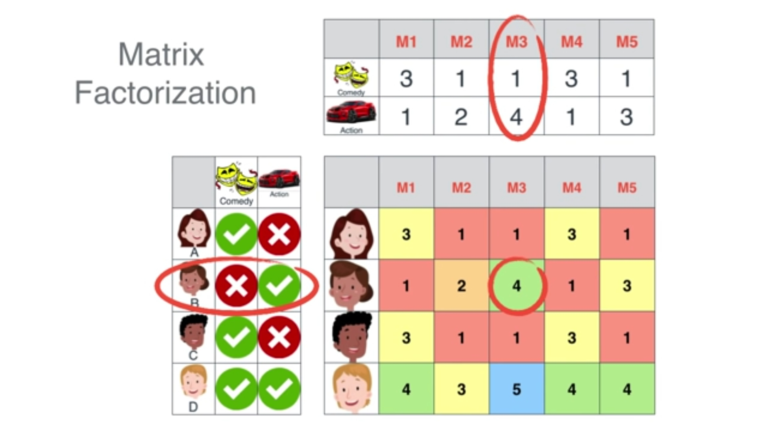
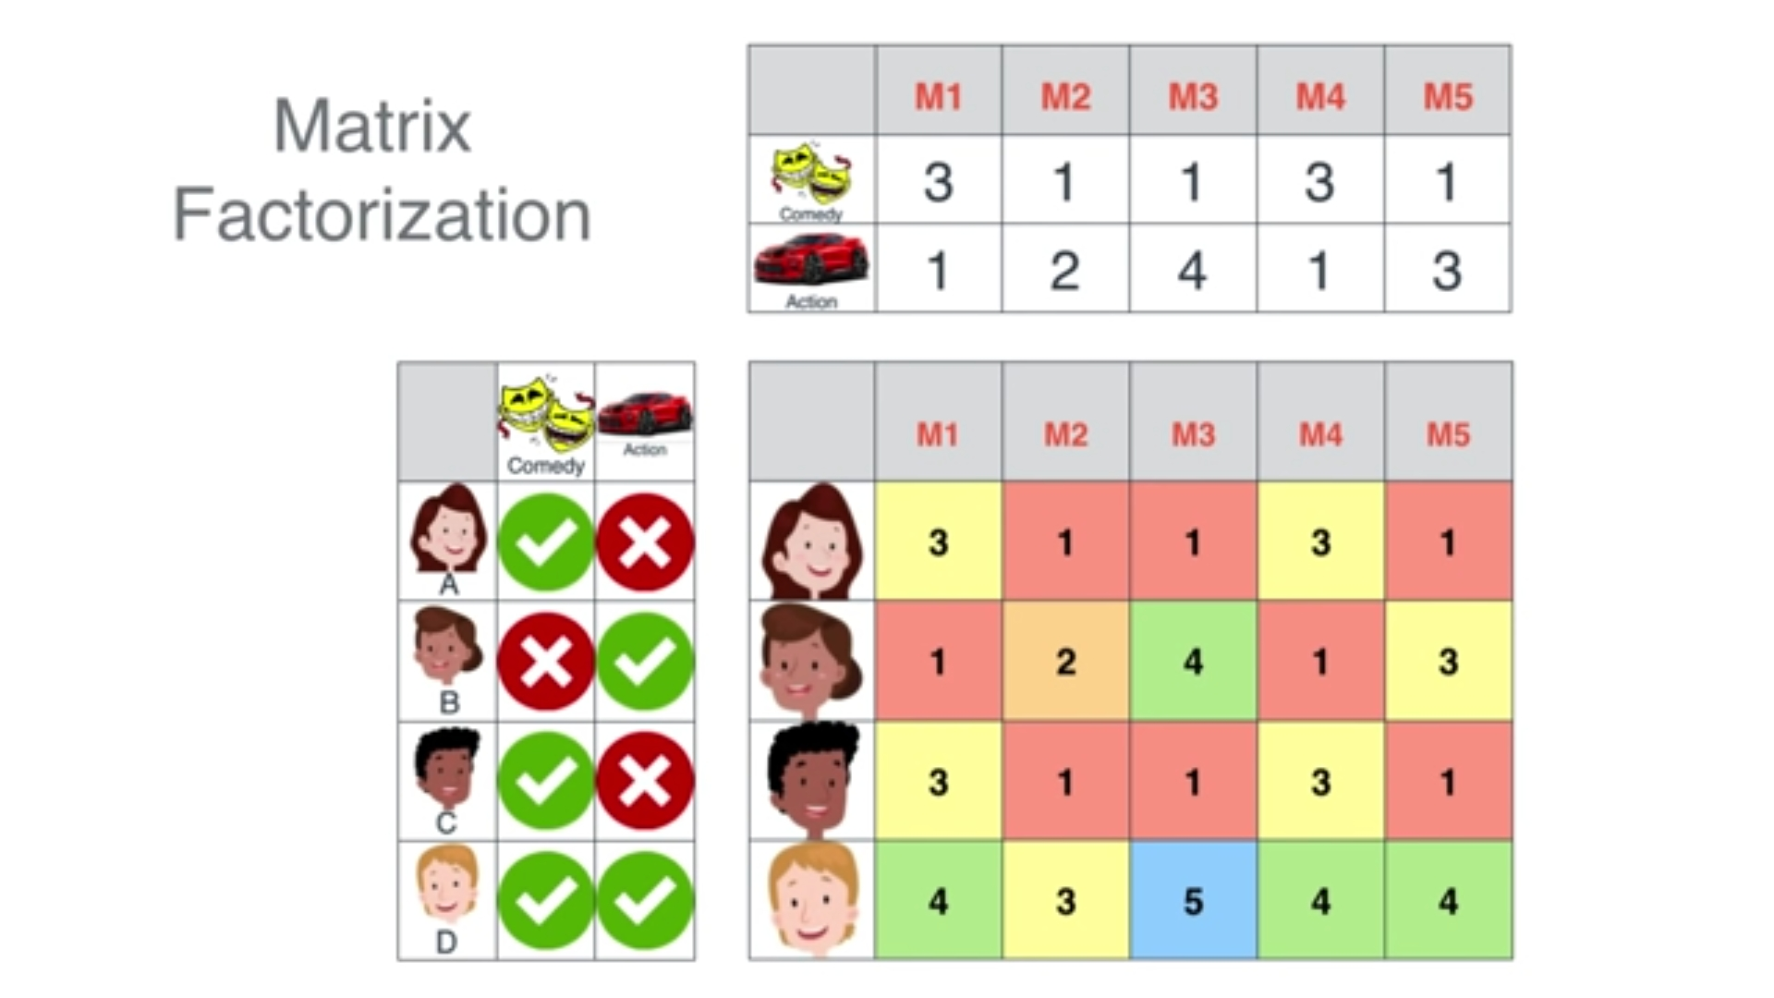

Slide 25
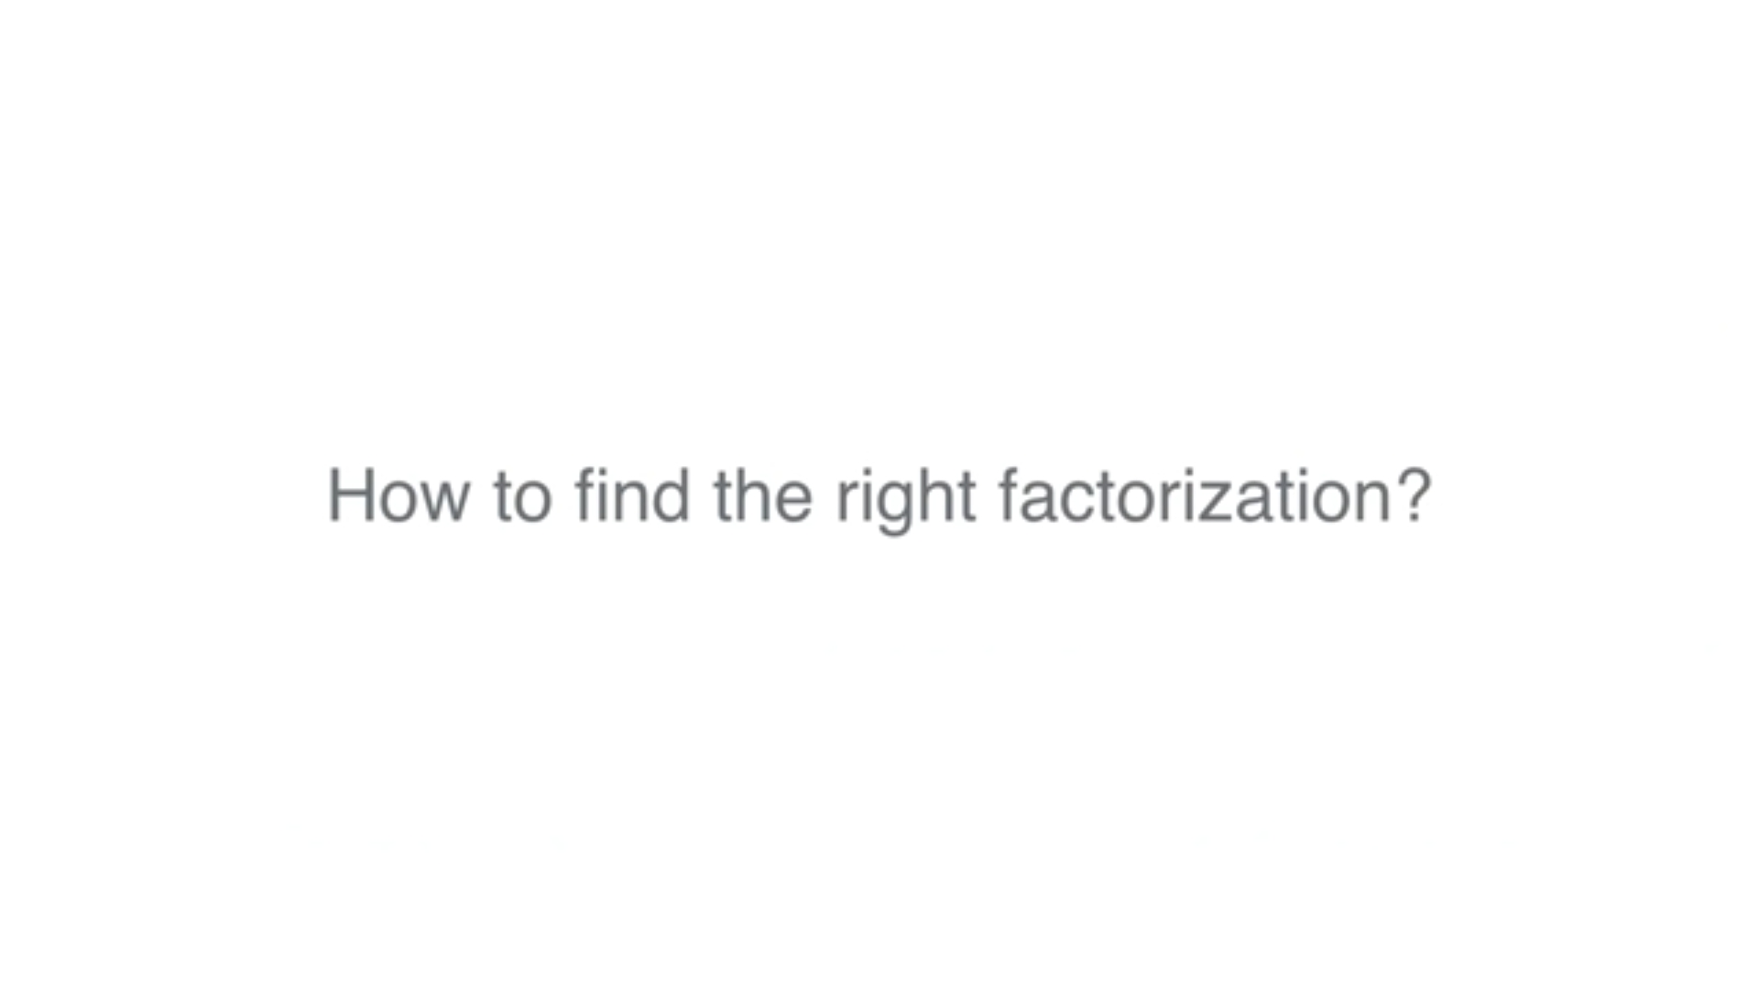

Slide 26
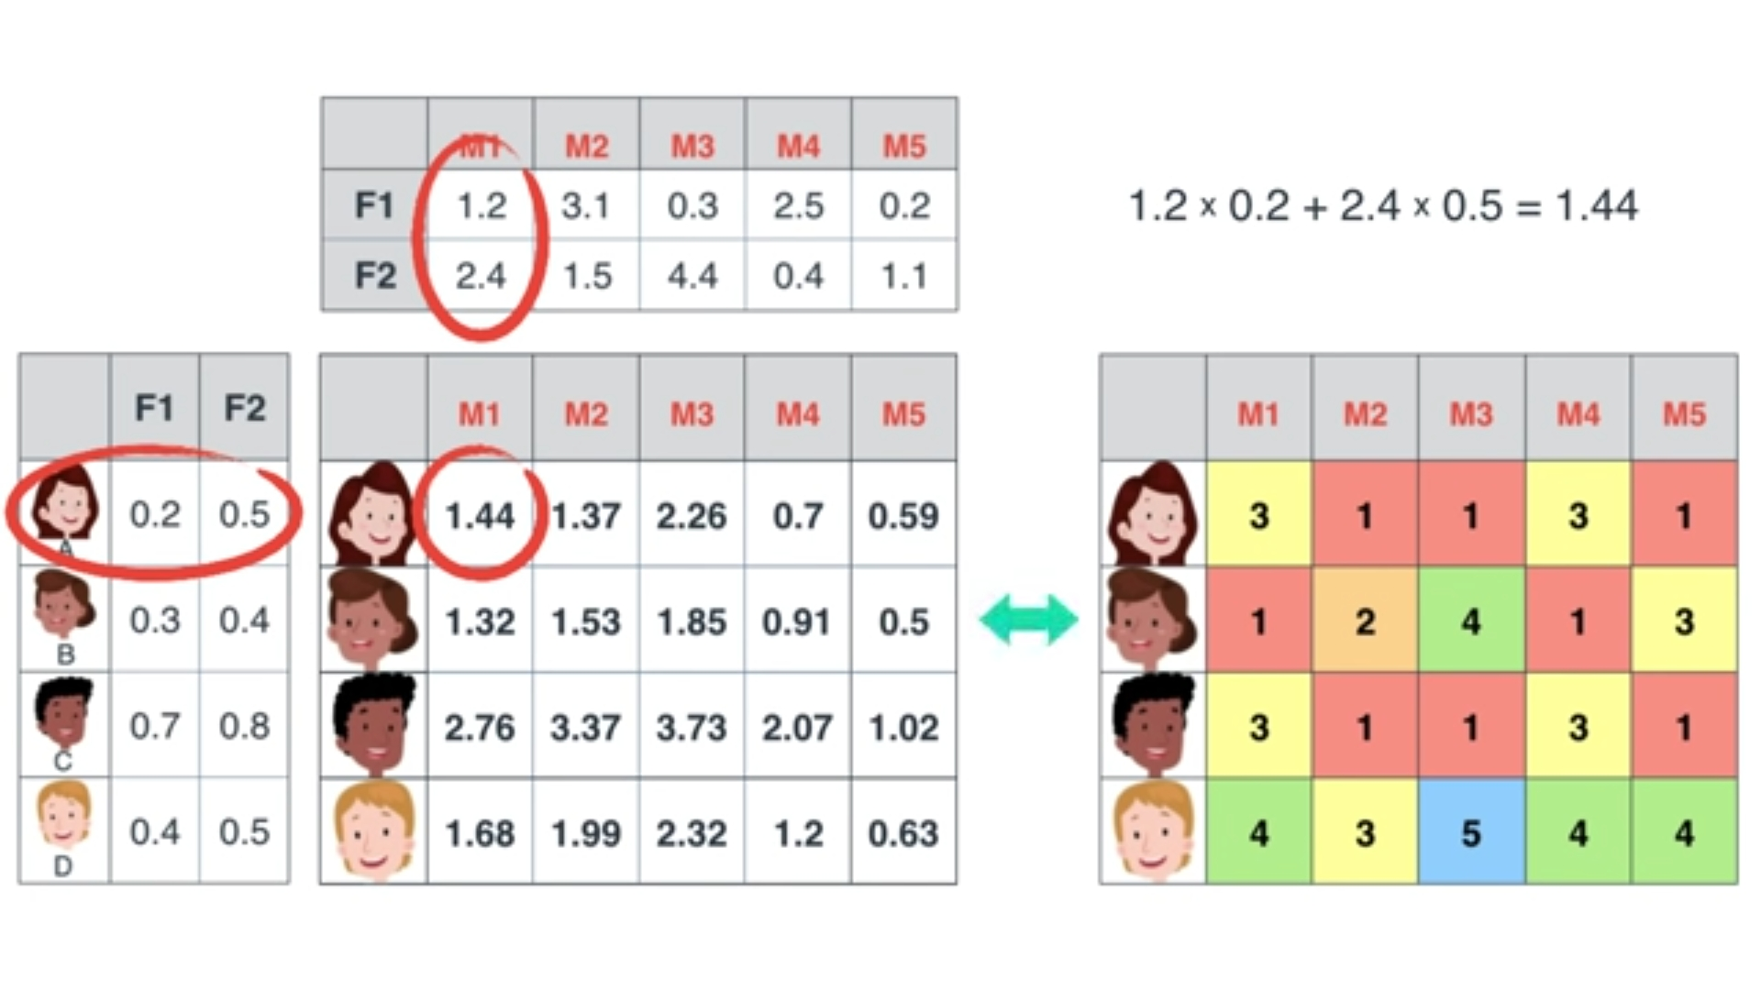

Slide 27
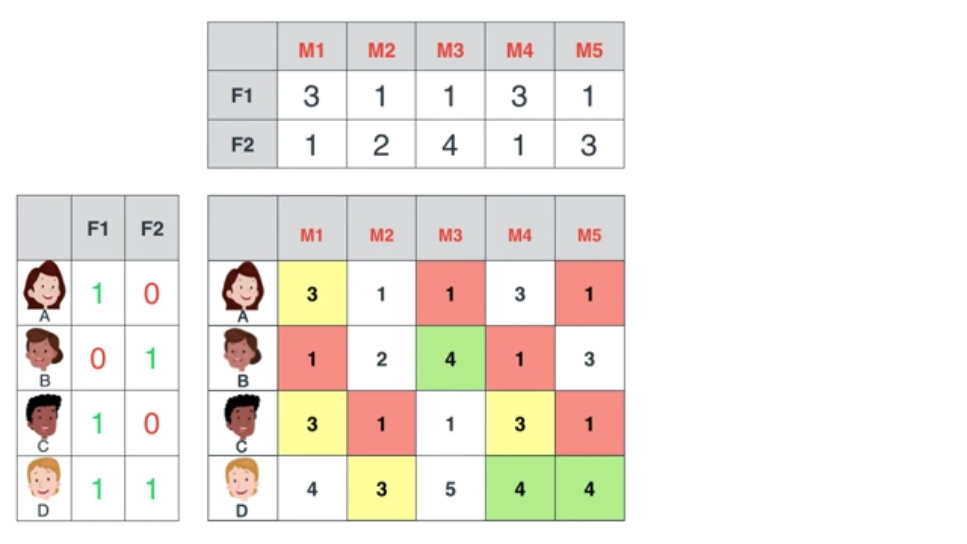

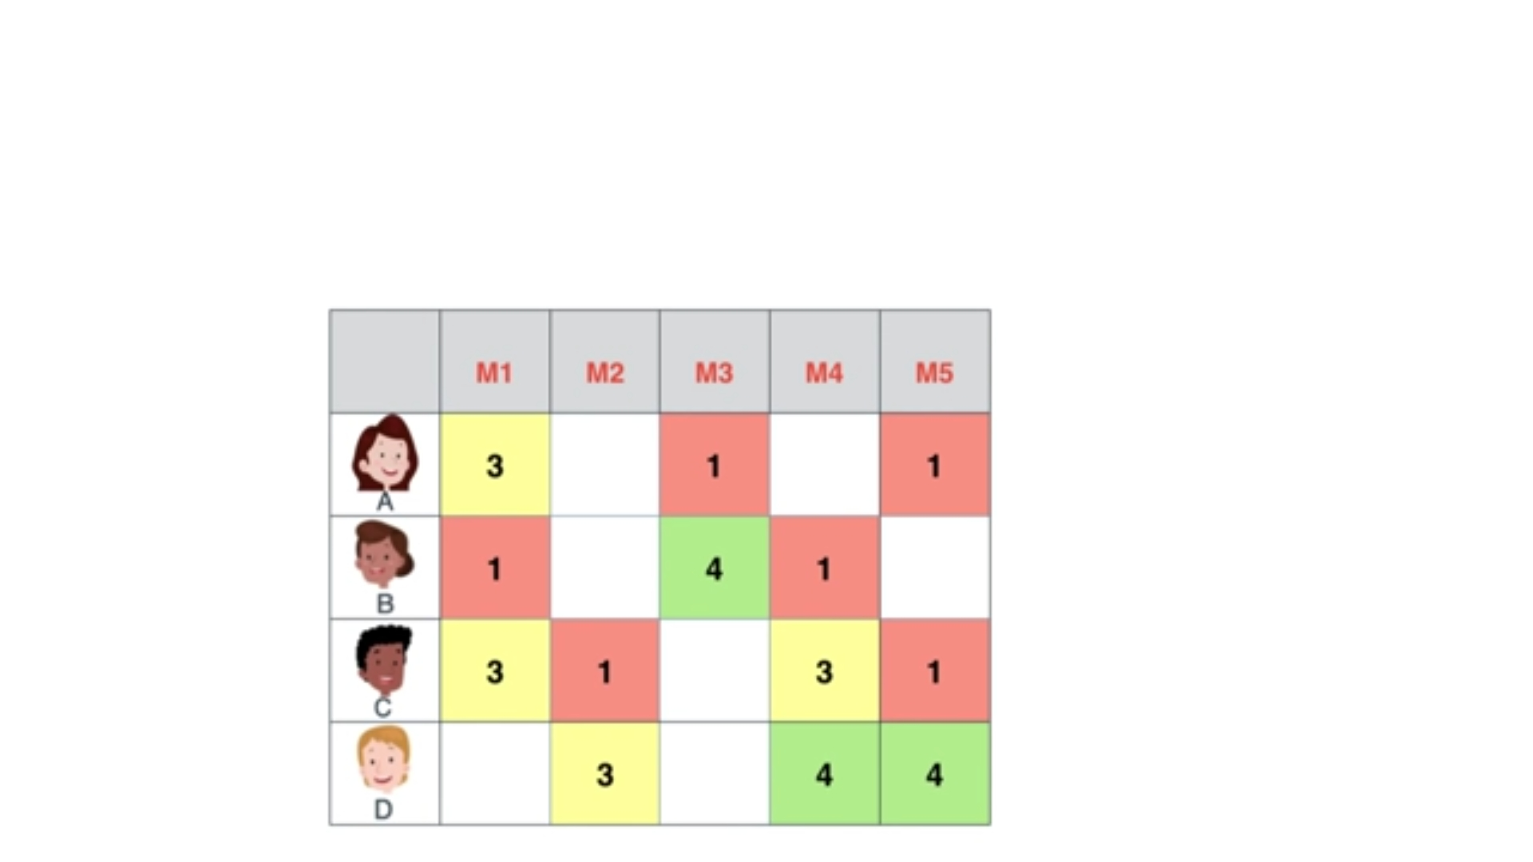

Slide 28
Problem statement

Slide 29
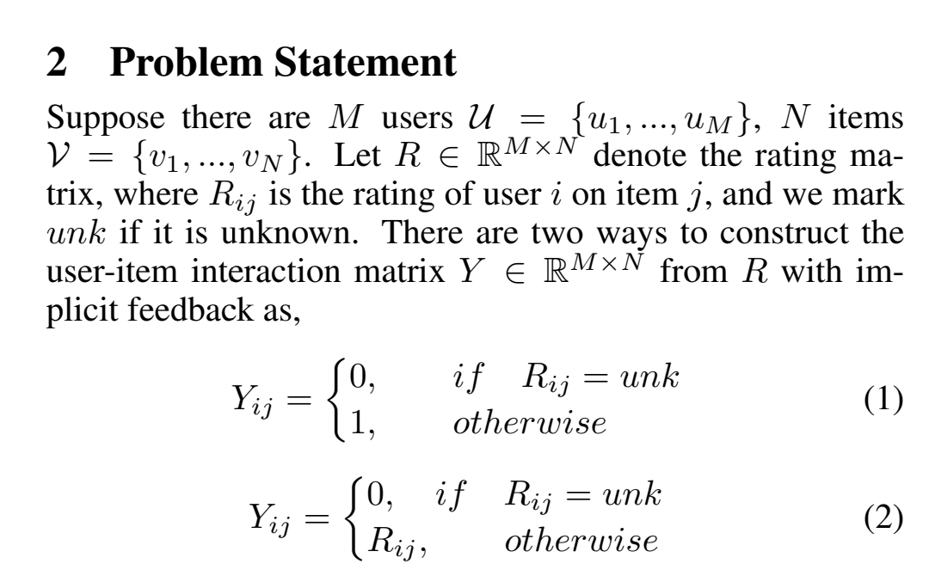

Slide 30
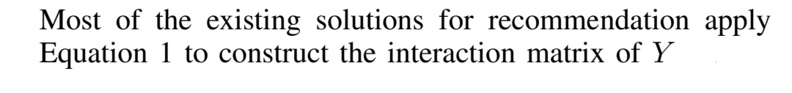
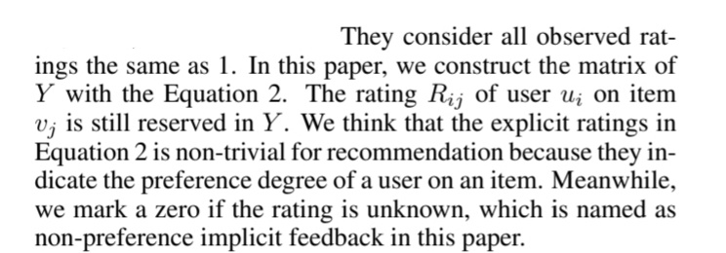

Slide 31
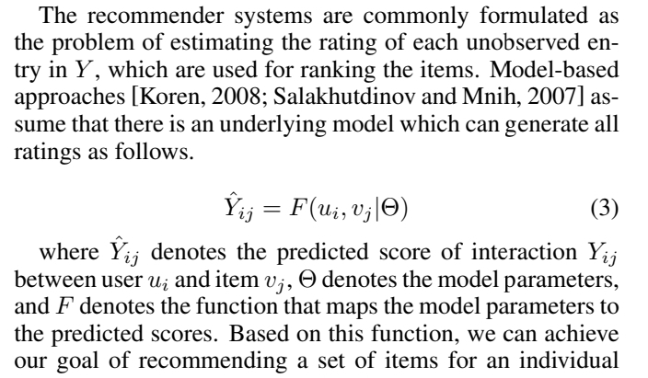

Slide 32
How to define such a function (f) ?

Slide 33
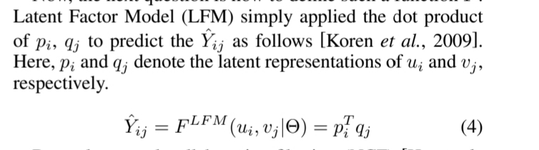

Slide 34
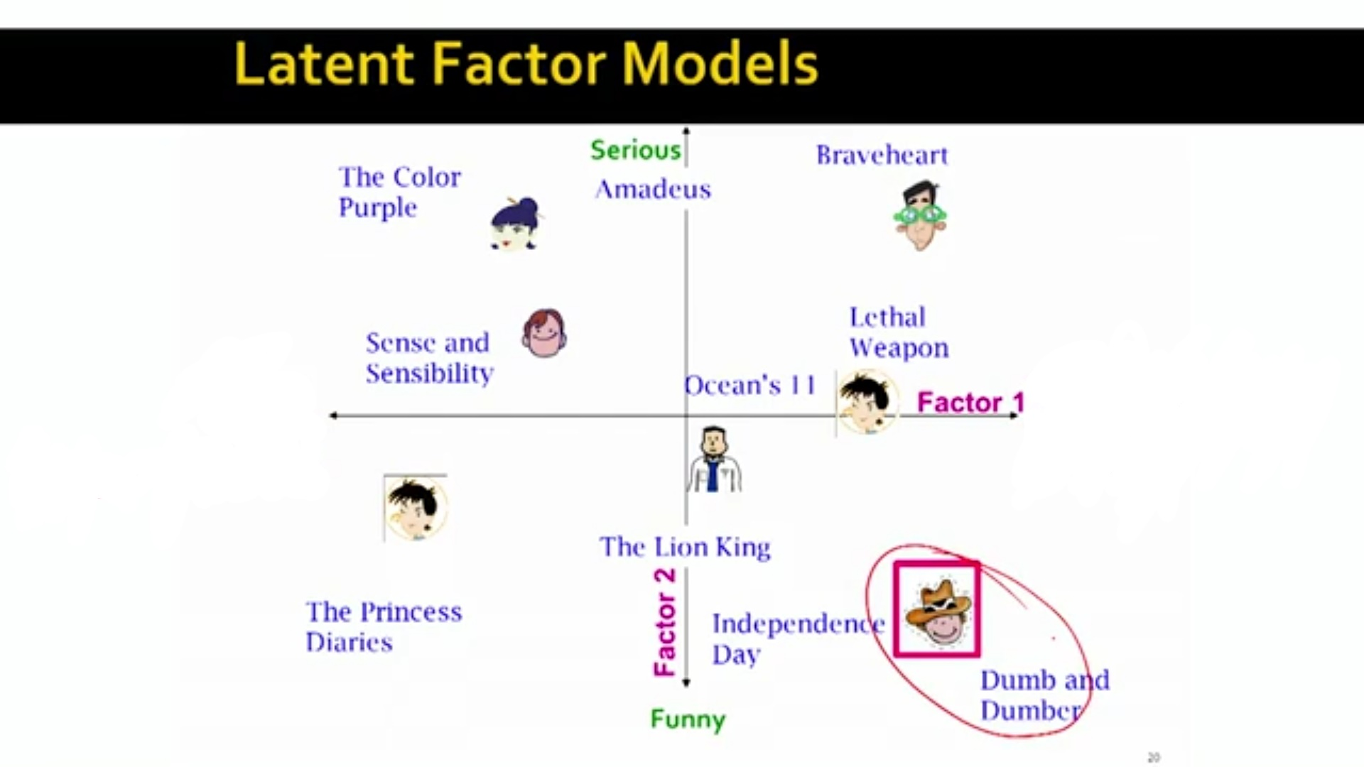
LESS Action
Action

Slide 36
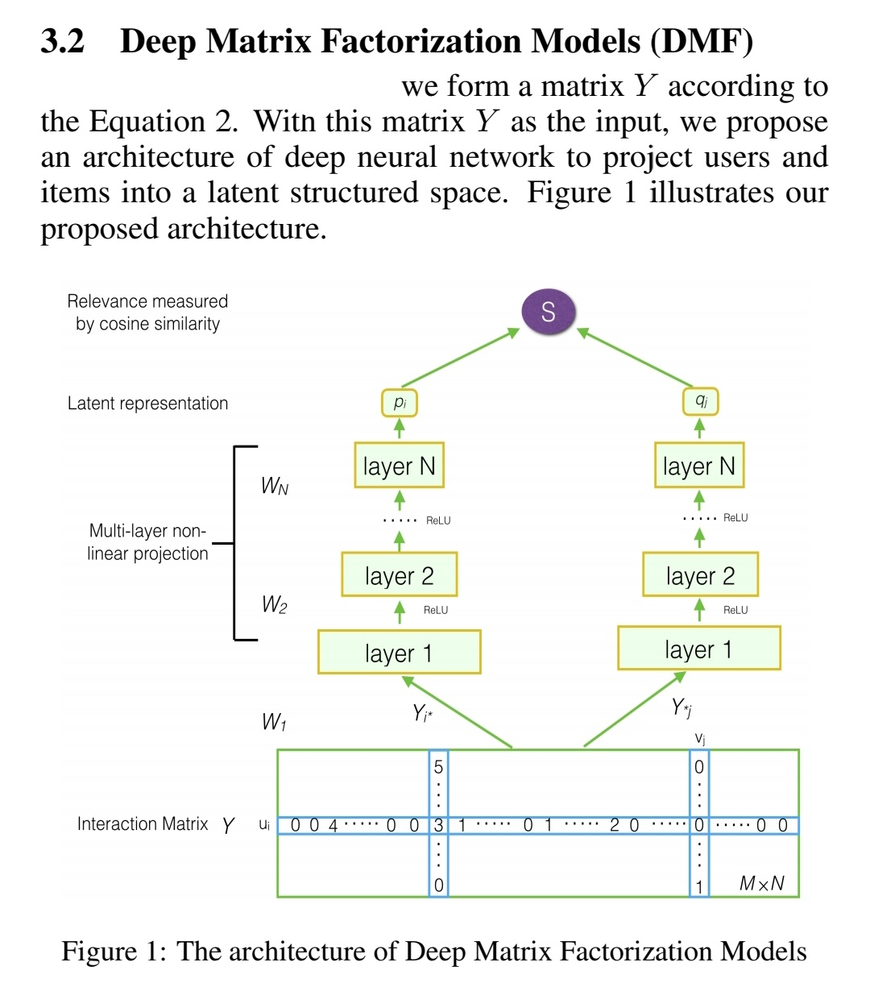

Slide 37
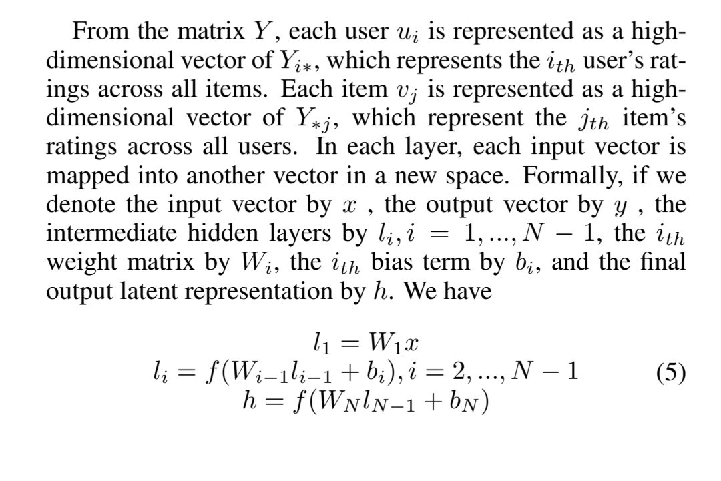

Slide 38
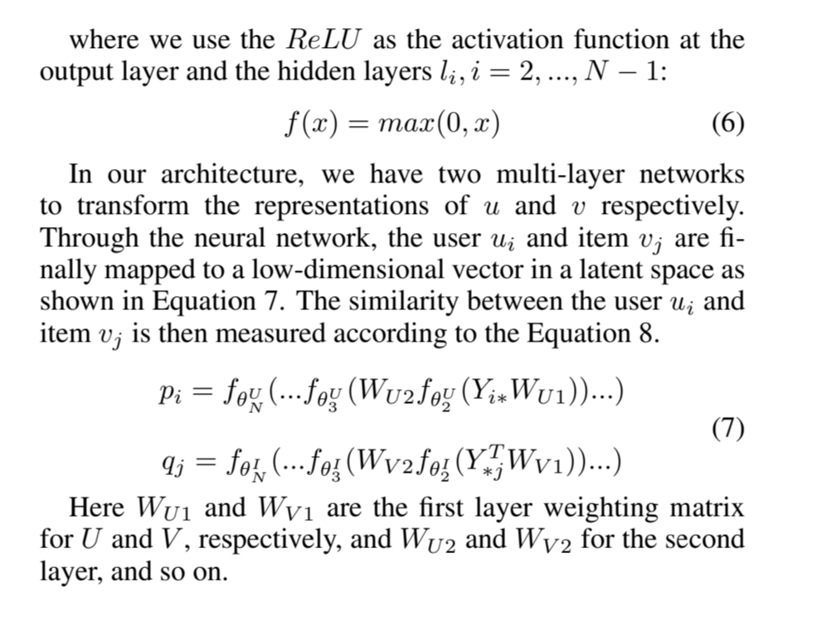

Slide 39
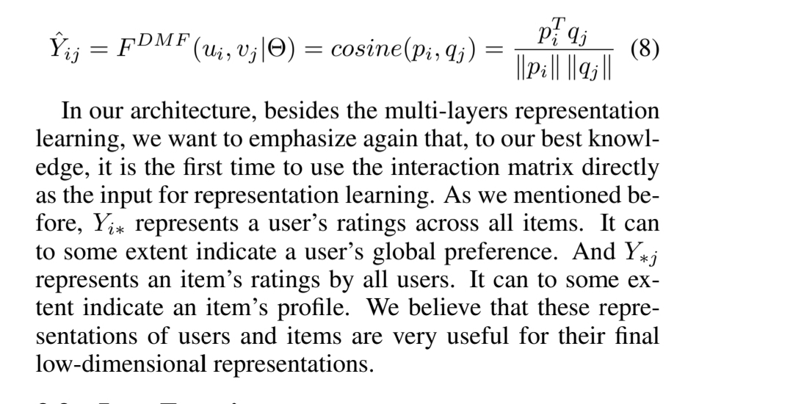

Slide 40
Loss function
Another key component for recommendation models is to define a proper objective function for model optimization according to the observed data and unobserved feedback.
For recommender Systems two types of objective functions:
In this paper (model) we will use point-wise objective
Point-Wise objective
Pair-Wise objective

Slide 41

The most important part of the objective function is the loss function which has four types:
Categorical Cross Entropy.
Binary Cross Entropy
Mean Absolute Error
Mean Squared Error
We will use Binary Cross Entropy because we are dealing with multilabel problem. And its formula is:
$$L= − \sum_{\left(i+j\right)∈Y^{+}∪Y^{−}}{Y_{i,j}Log\left(\hat{Y_{i,j} }\right)+ }(1−Y_{i,j})Log(1−\hat{Y_{i,j} })$$

Slide 42

But this function will only work with the implicit ratings and in our model we are working with implicit and explicit rating so we design a new loss function which incorporate explicit ratings with Binary Cross Entropy by Normalizing our main matrix and we name our new loss function as Normalized Cross Entropy loss (NCE) which has the formula:
$$L= − \sum_{\left(i+j\right)∈Y^{+}∪Y^{−}}{(Y_{i,j}/Max(R))Log\left(\hat{Y_{i,j} }\right)+ }(1−(Y_{i,j}/Max(R)))Log(1−\hat{Y_{i,j} })$$
Where Max(R) is the maximum rating. Ex: 5 in 5-Stars rating System

Slide 43
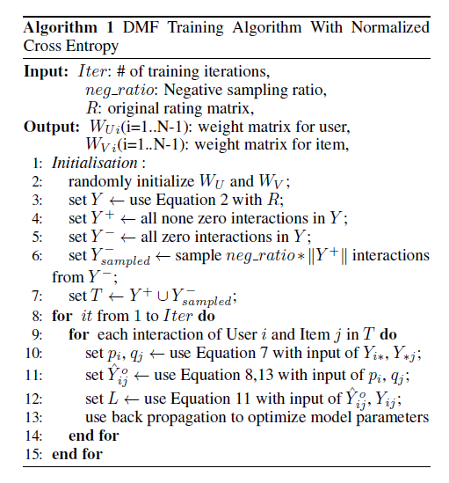

Slide 44

For cross entropy loss, because the predicted score of Y_{ij} can be negative, we need to use Equation __ to transform the original predictions. Let µ be a very small number, and we set 1.0e⁻⁶ in our experiments.
$$\hat{Y_{i,j} }=\max\left(μ,\hat{Y_{i,j} }\right)$$
In the previous algorithm, we present the high-level training process of DMF model. For training the parameters of weight matrix WU and WV on each layer, we use back propagation to update the model parameters with batches. The complexity of our algorithm is linear to the size of matrix and the layers of network.

Slide 45
Experiments and results
Used data sets
Evaluation for RSs
Implementation details
Performance comparison
Sensitivity to hyper-parameters

Slide 46
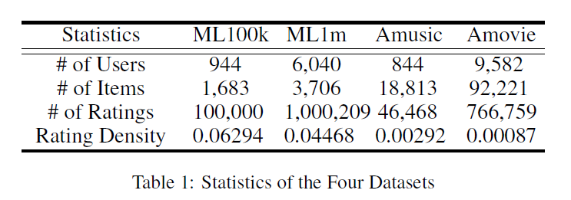
Datasets

Slide 47
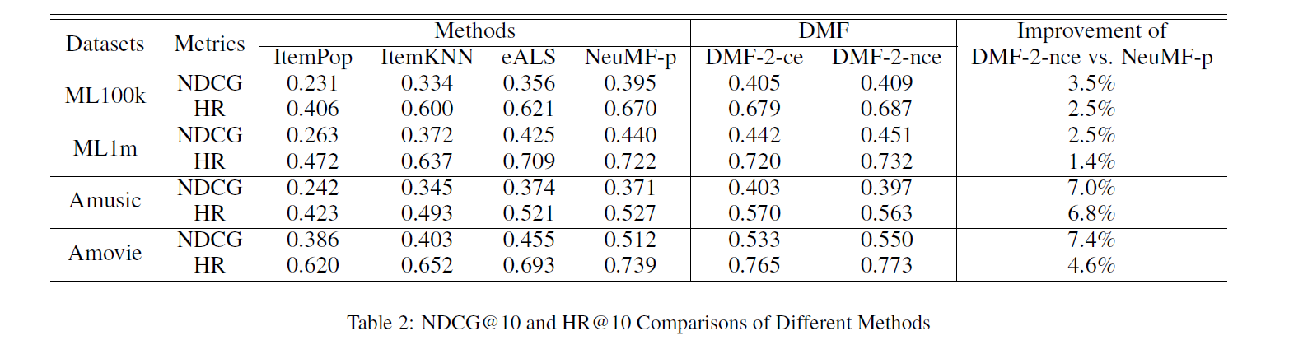
Evaluation and comparison

Slide 48
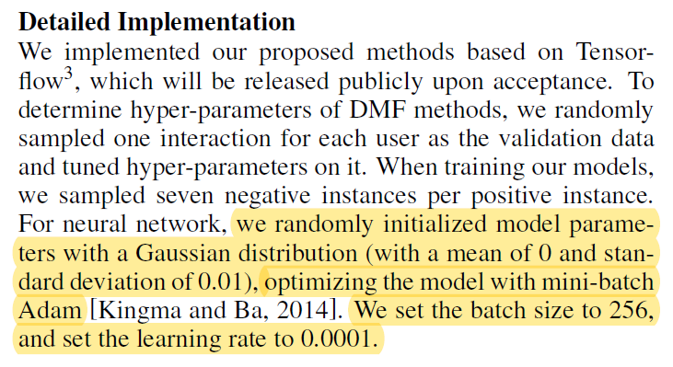
Implementation details

Slide 49
sensitivity
Negative ratio
Number of layers
Factors of the final latent space

Slide 50
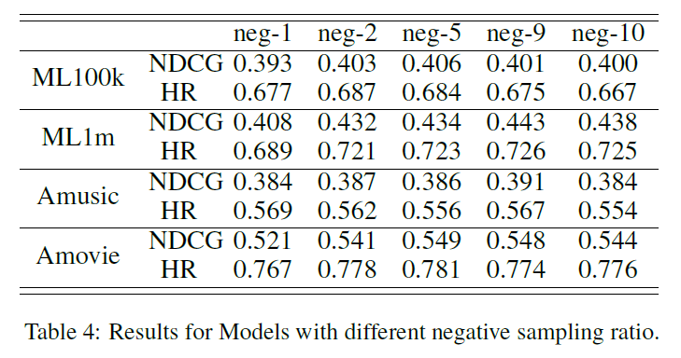

Slide 51
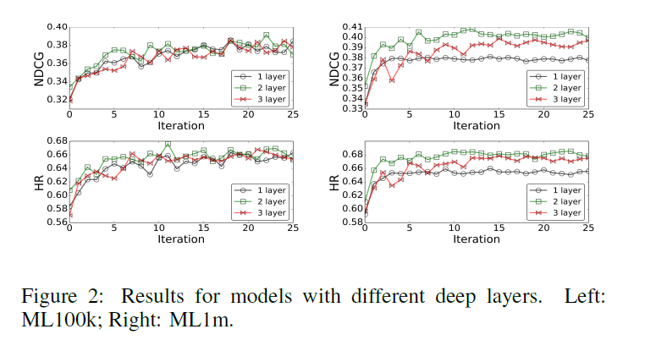

Slide 52
